Slide 1
Project: Suicide Data Analysis and Visualization
22CD3011
Gautam Kumar

Slide 2
Section A
Indian suicide data Analysis and Visualization using Power Bi Tool

Slide 3
01
Introduction
02
Source of data
03
Sum of no of suicide by year
04
Sum of No of suicide by Gender
Table Of Contents
05
Sum of No of suicide by State
06
Sum of no of suicide by Reason of Professiona_Profile
07
Sum of no of suicide by Reason of Mean_adopted
Sum of no of suicide by Reason of Suicide of Social_Status
08
Sum of no of suicide by Reason of Suicide of Education_Status
09

Slide 4
Sum of no of suicide by Reason of suicide of Causes
10
11
Sum of no suicide by Type code
Sum of no suicide by Type cod and Gender
12
Table Of Contents
13
Sum of no suicide by Age Group
Sum of no suicide by Age Group and Gender
14

Slide 5
Section B
World suicide data Analysis and Visualization using Python Tool

Slide 6
01
Introduction
02
Source of data
03
Data preparation , Cleaning and visualization code
04
Average suicide rate of each country
Table Of Contents
05
Yearly suicide rate analysis
06
Country + year suicide rate analysis
07
Checking suicides_no by age-group
08
Country+gender suicide rate analysis
09
Count of suicides by gender

Slide 7
10
Age+Gender suicide rate analysis
11
Generation Analysis
12
Generation + Age analysis
Table Of Contents
13
Maximum Suicides Number Country
14
GDP per Capita for All Countries
15
Top 10 country highest GDP
16
Top 10 country highest Suicide Rates
17
Top 10 country lowest GDP
18
Top 10 country Lowest Suicide Rates

Slide 8

Introduction
Suicide, derived from Latin suicidium, is "the act of taking one's own life". Attempted suicide or non-fatal suicidal behavior amounts to self-injury with at least some desire to end one's life that does not result in death.

Slide 9



In 2015, suicide was the second cause of death worldwide among people aged 15–29 years, and the seventh among those aged 30–49 years (WHO 2017).
Suicide is a significant public health concern in India, with high rates influenced by a range of factors including financial stress, family issues, and stigma around mental health. While historically more men have died by suicide, the gender gap is narrowing, particularly among young women. The Indian government has initiated programs to increase awareness, improve mental health services, and reduce the stigma associated with mental health issues as part of suicide prevention efforts. Addressing this complex issue requires a comprehensive approach, focusing on mental health support, economic opportunities, and social networks.

Slide 10

Every death from suicide is a tragedy. But research shows that its rates can be reduced with greater understanding and support.
To do this, suicide should be recognised as a public health problem, and people should know that it can be prevented and its rates can be reduced.
On this page we show data on the prevalence of suicide across the world, its risk factors, and how these trends are changing over time.

Slide 11
Objective:
The objective of this project is to analyze and visualize global and Indian suicide data to better understand the trends, patterns, and factors associated with suicide rates worldwide. Through this analysis

Slide 12

Source of Data
Data source: Kaggle
Data name : Data of World suicide and Indian suicide
Click here to view data

Slide 13
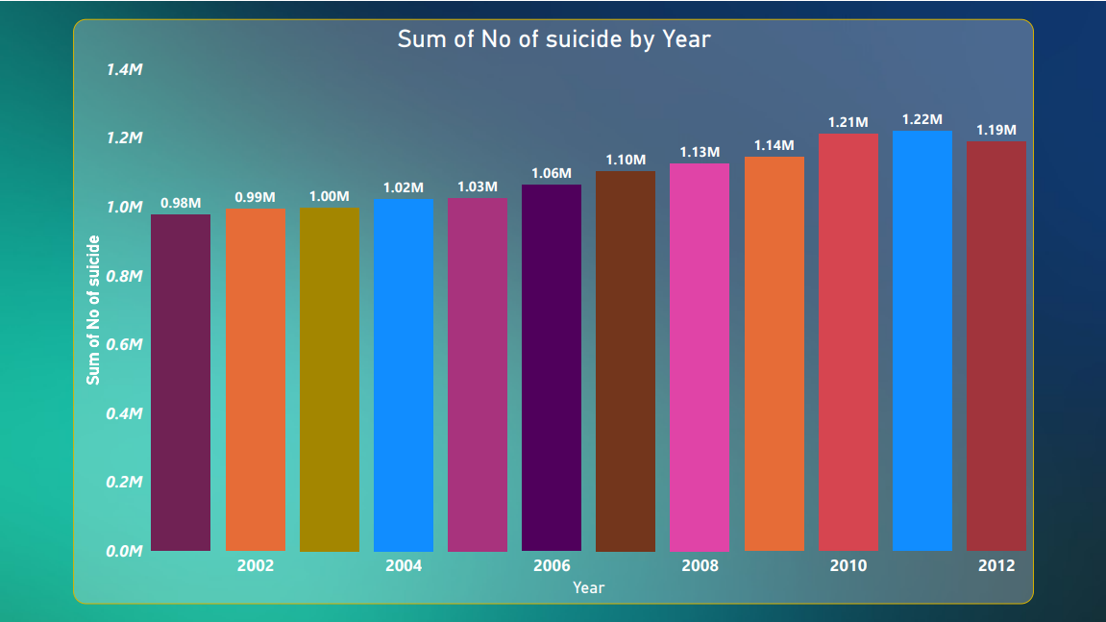

Slide 14
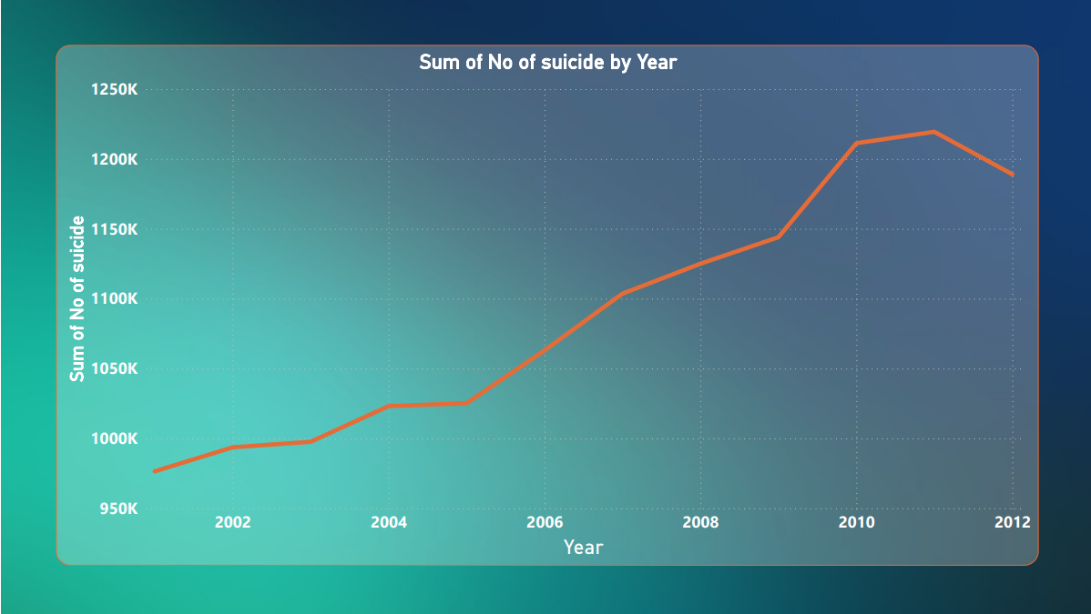

Slide 15

So, we can conclude from above graph -:
The highest number of suicides occurred in 2010 and 2011, while the year 2000 saw the lowest number. It appears that there was a gradual increase in suicides, but in 2012, the numbers decreased compared to 2010 and 2011.

Slide 16
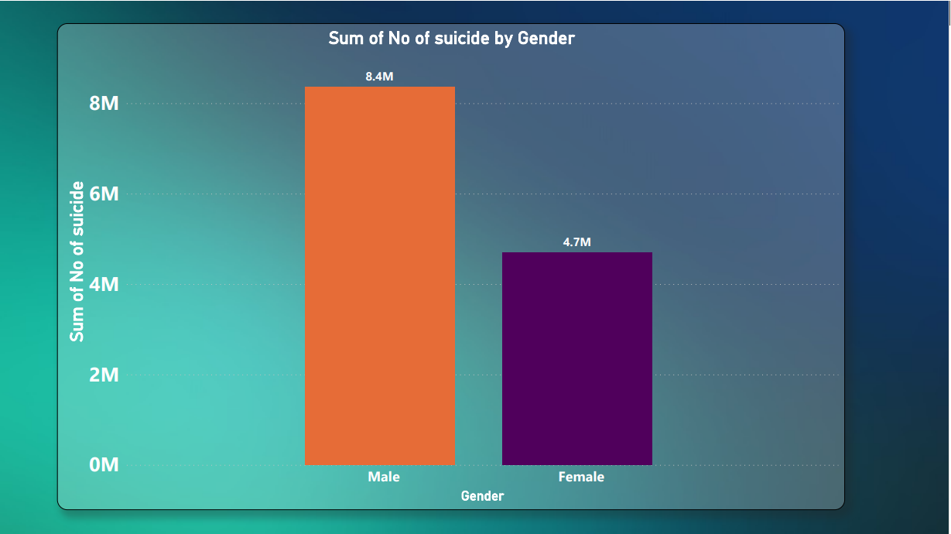

Slide 17
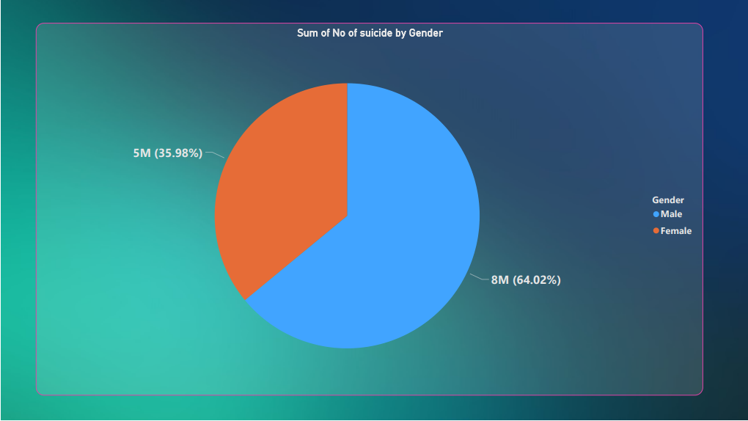

Slide 18
So, we can conclude from above graph -:
More males die by suicide compared to females. It appears that the number of male suicides is approximately double that of females, with 8.4 million males (64.2%) and 4.7 million females (35.98%).

Slide 19
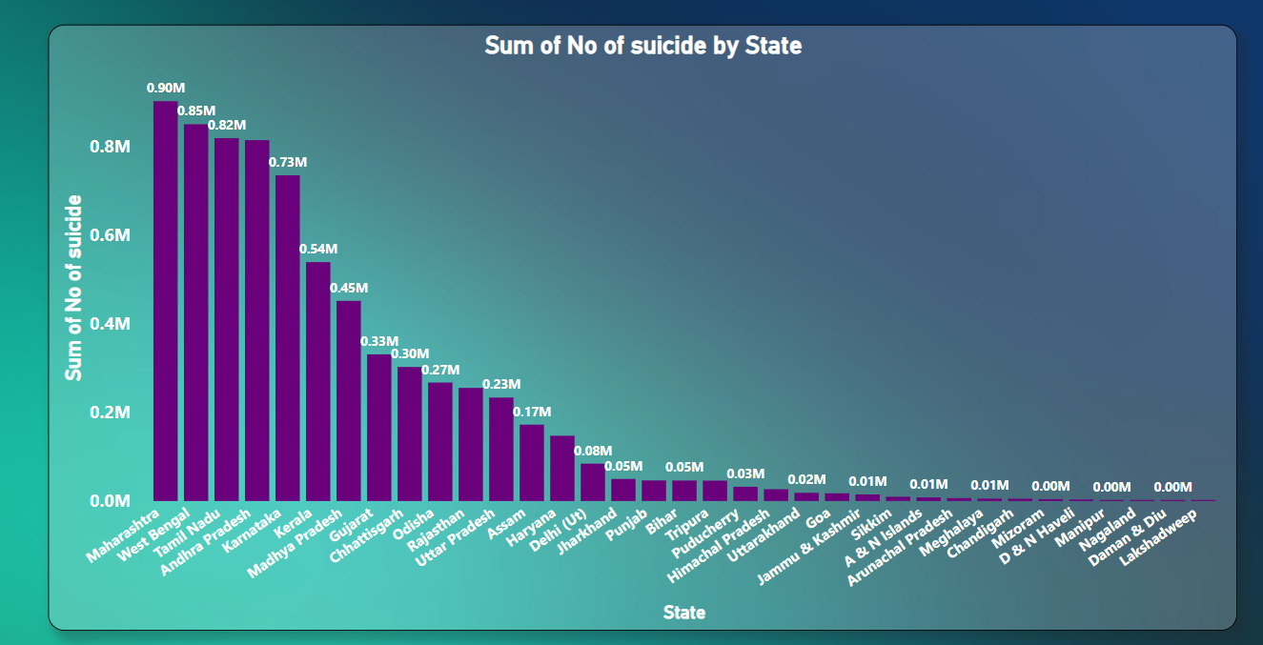

Slide 20
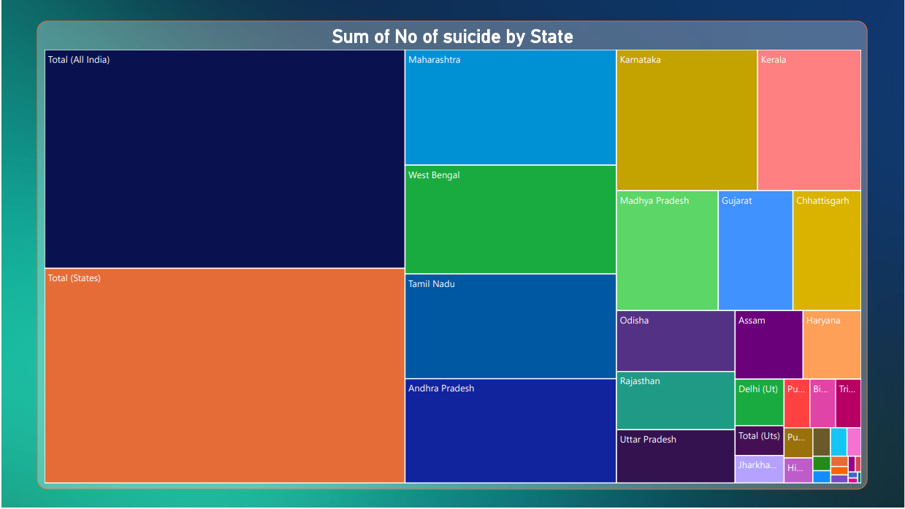

Slide 21
So, we can conclude from above graph -:
Maharashtra, West Bengal, Tamil Nadu, and Andhra Pradesh have the highest suicide rates, while Nagaland, Daman & Diu, and Lakshadweep have the lowest suicide rates.

Slide 22
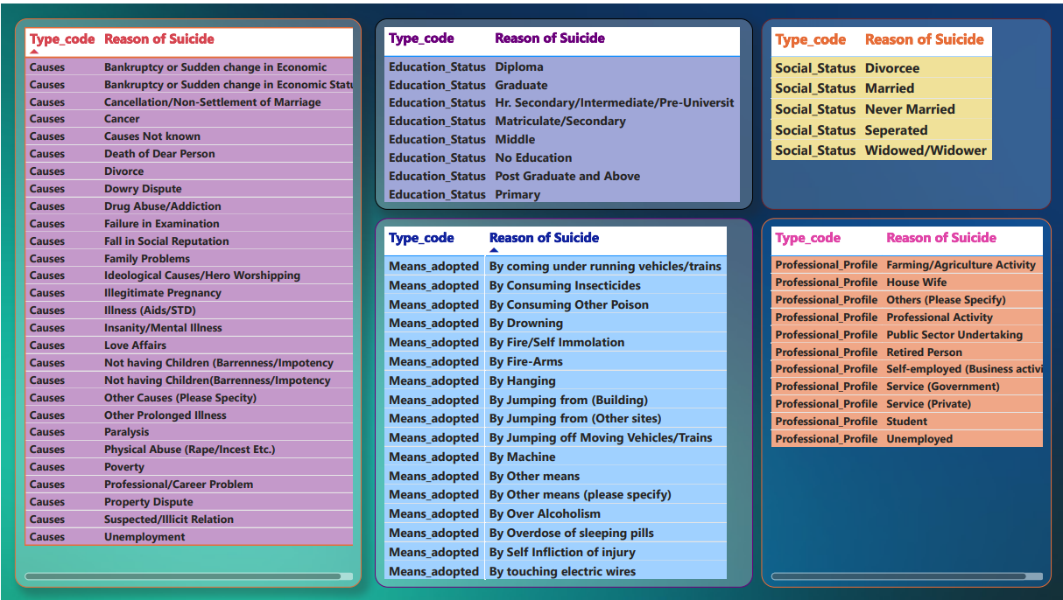

Slide 23
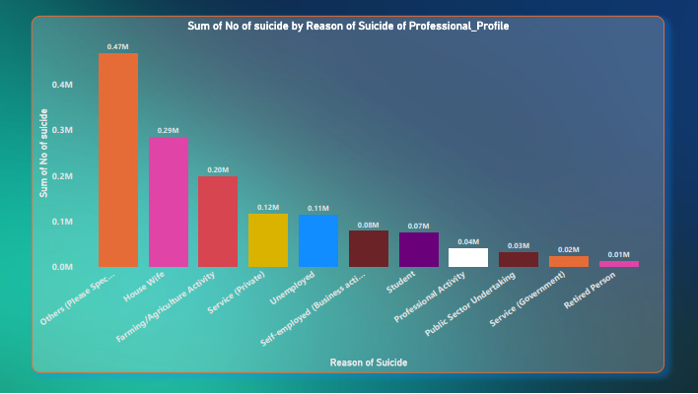

Slide 24
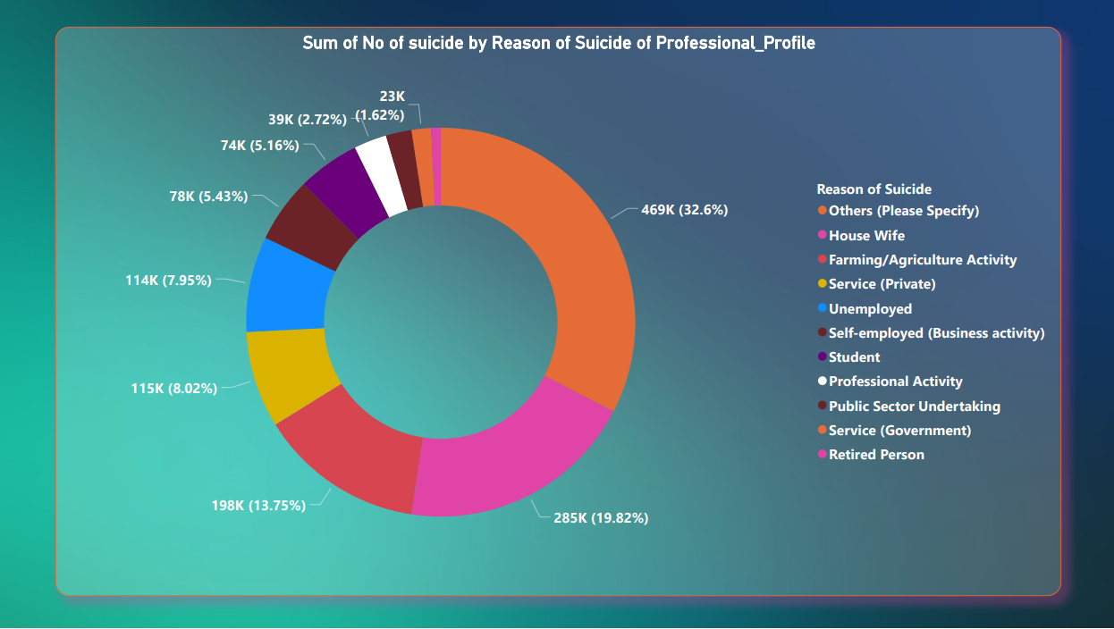

Slide 25
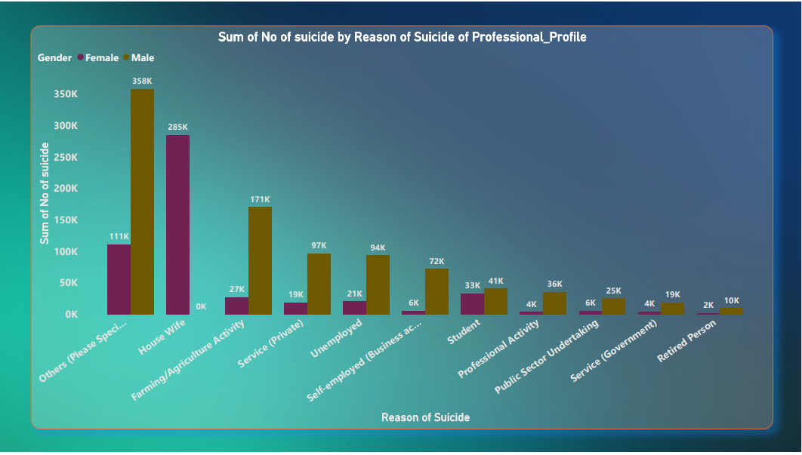

Slide 26
So, we can conclude from above graph -:
Housewives and individuals engaged in farming and agriculture activities have the highest number of suicides, while those in government service and retired individuals have the lowest suicide rates. The suicide rate is highest among males compared to females, but among housewives, it is exclusively among females.

Slide 27
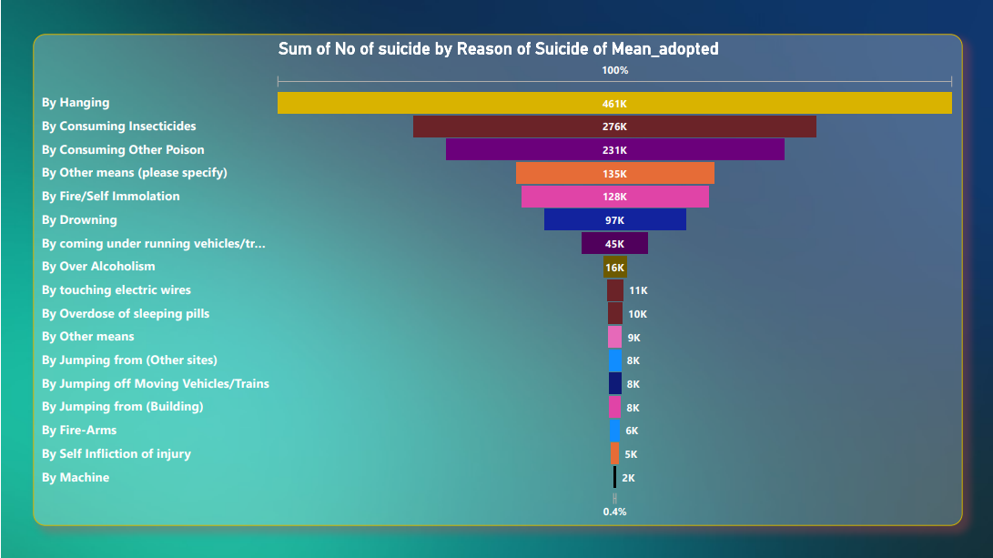

Slide 28
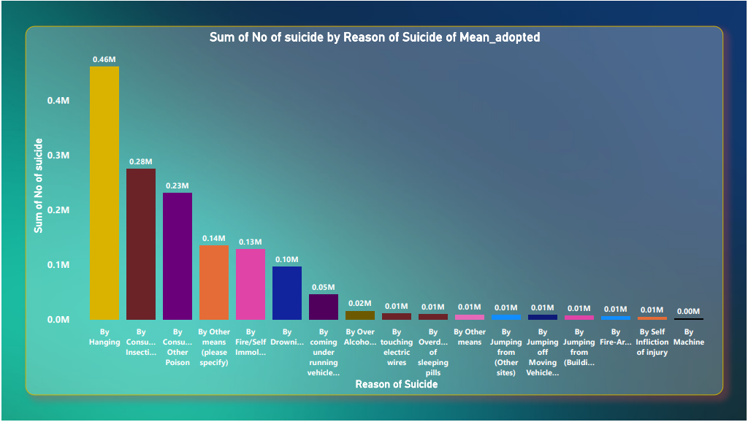

Slide 29
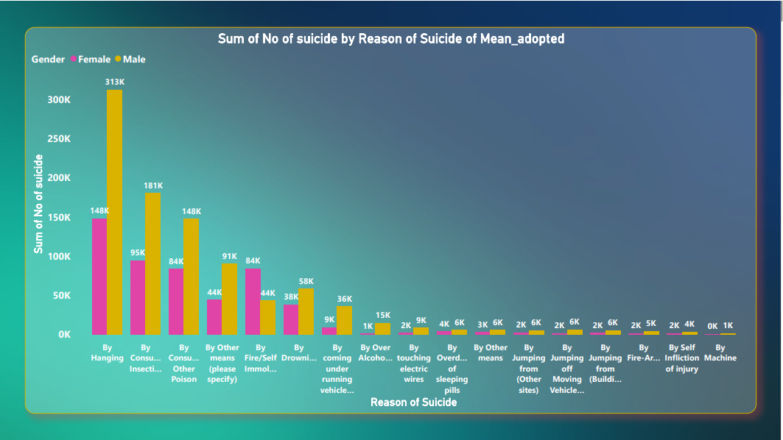

Slide 30
So, we can conclude from above graph -:
Hanging is the most common method for suicide, while machine-related methods have the lowest number of suicides. The number of male suicides is nearly double that of females.

Slide 31
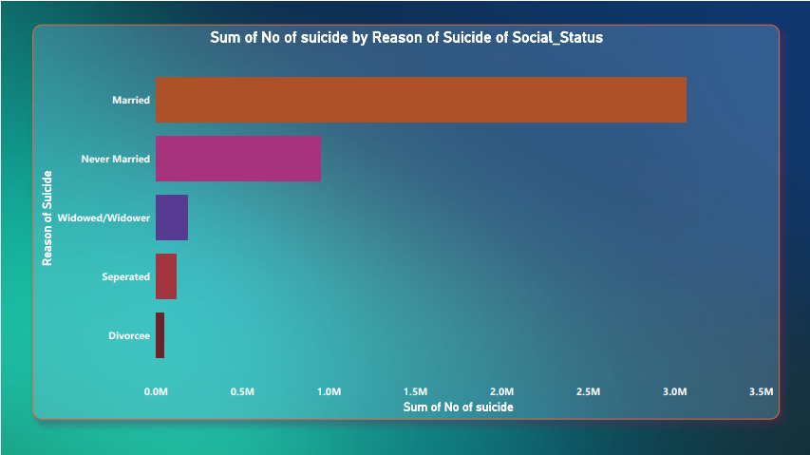

Slide 32
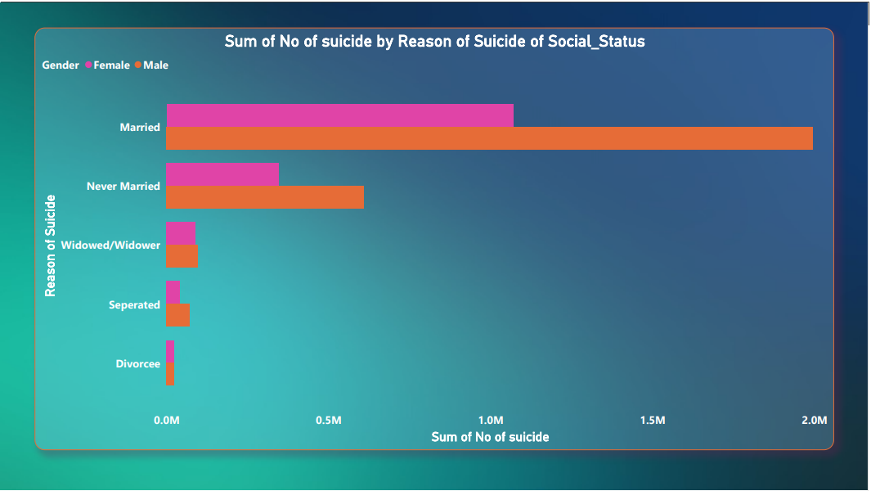

Slide 33
So, we can conclude from above graph -:
Married individuals have the highest number of suicides compared to other social statuses, while divorcees have the lowest suicide rate, and males have the highest suicide rate compared to females.

Slide 34
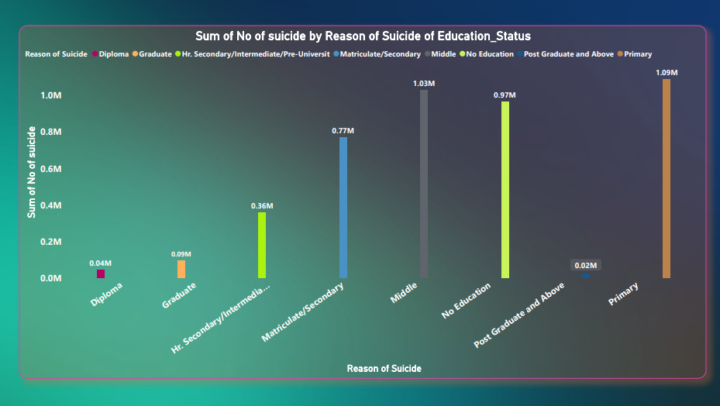

Slide 35
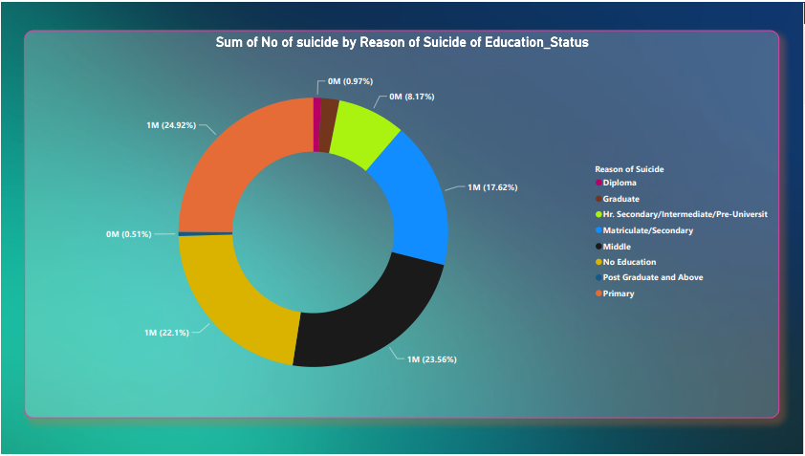

Slide 36
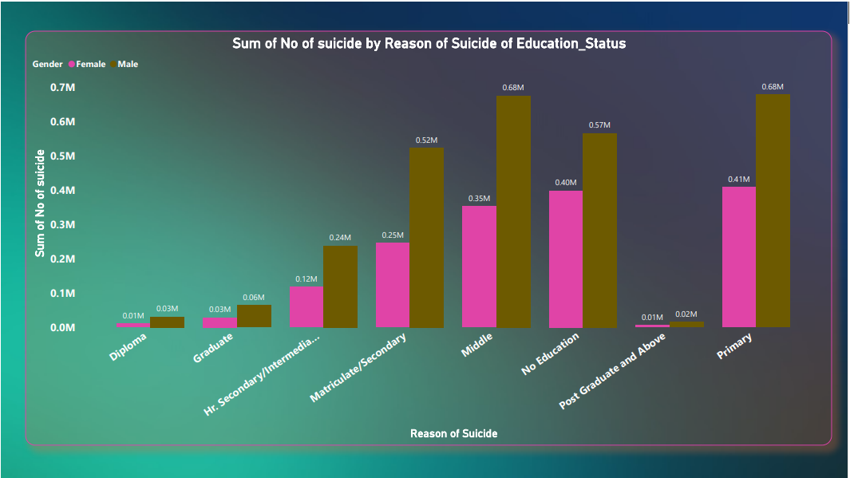

Slide 37
So, we can conclude from above graph -:
Individuals with no education, those in the primary and middle-class categories, have the highest suicide rates, while those with postgraduate or higher education and diploma holders have the lowest suicide rates. The male suicide rate is almost double that of females.

Slide 38
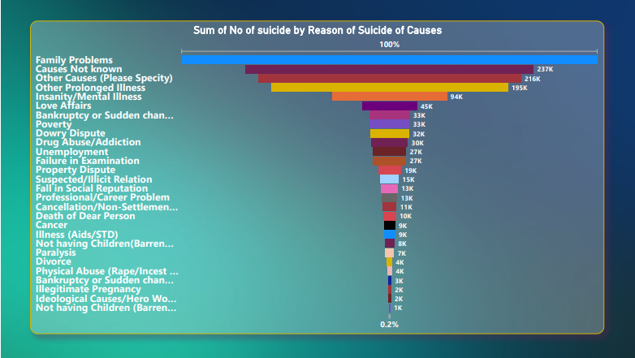

Slide 39
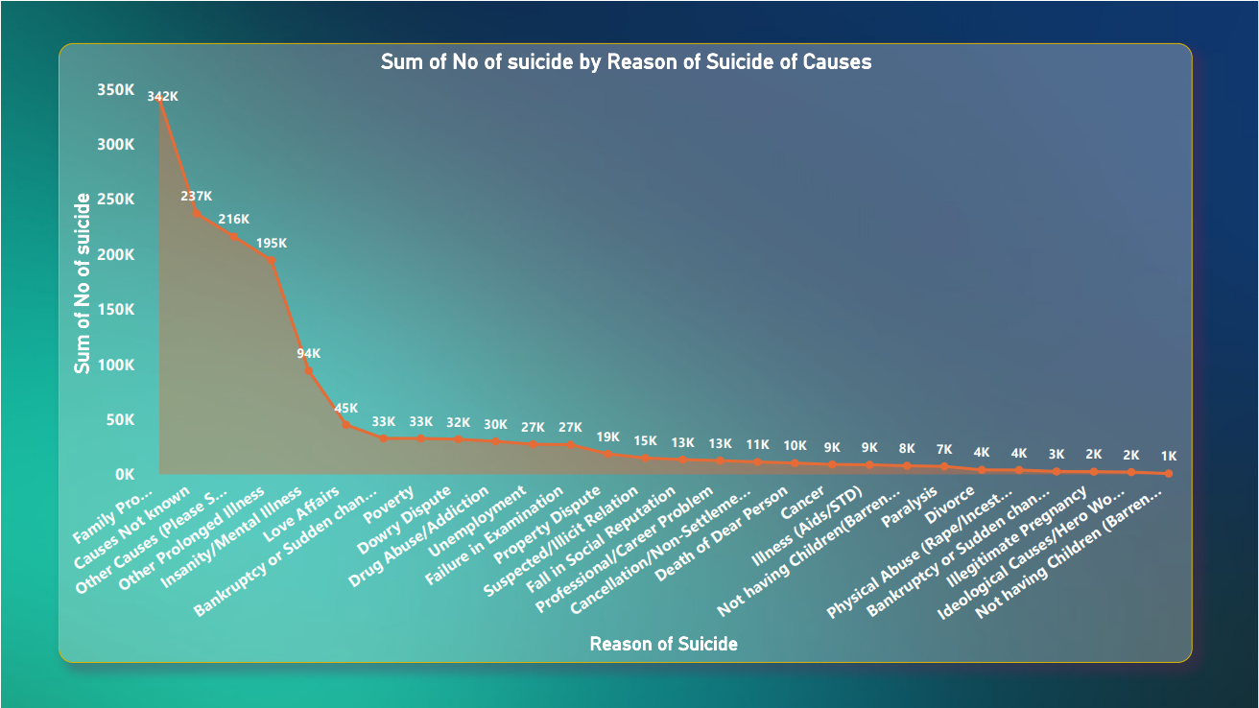

Slide 40
So, we can conclude from above graph -:
Family problems have the highest suicide rate, while not having children is associated with the lowest suicide rates.

Slide 41
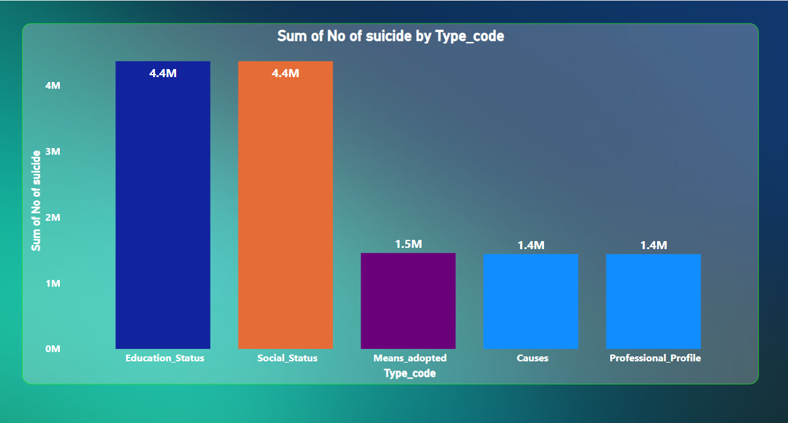

Slide 42
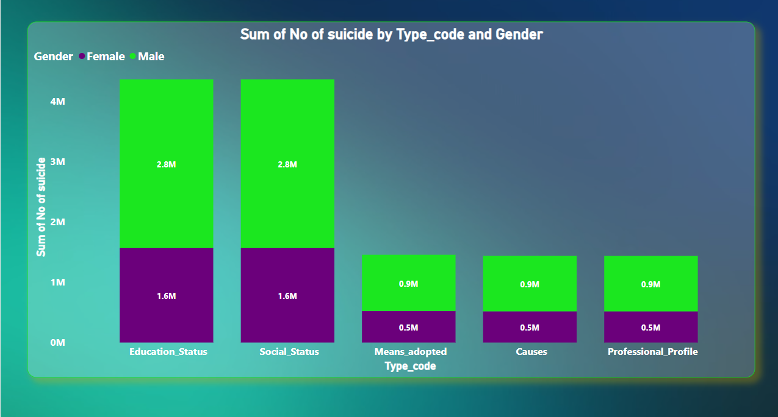

Slide 43
So, we can conclude from above graph -:
Education status and Social status have the highest suicide rates, while being adopted, the cause of suicide, and one's professional profile have the lowest suicide rates. Additionally, males have a higher suicide rate compared to females

Slide 44
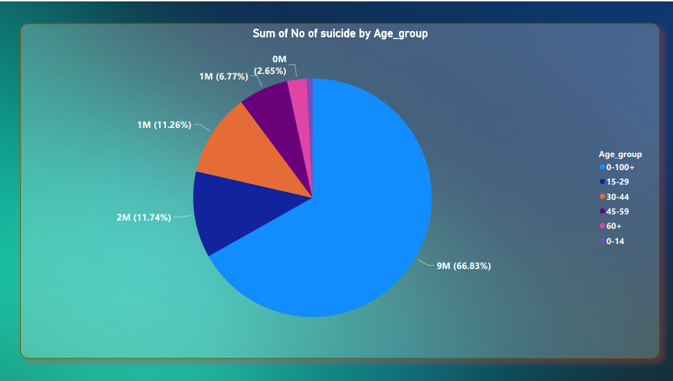

Slide 45
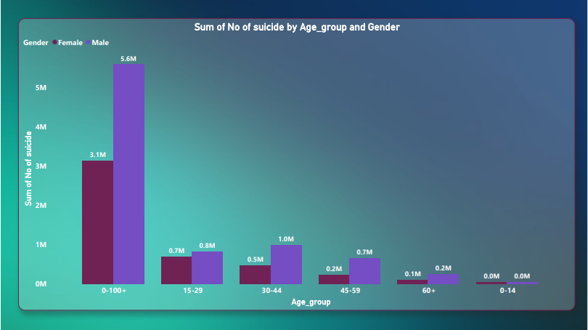

Slide 46
So, we can conclude from above graph -:
The age groups 15-29 and 30-44 have the highest suicide rates, while the age groups 0-14 and 60+ have the lowest suicide rates. Additionally, males have a higher suicide rate compared to females.

Slide 47
Conclusion of this data set :
Males tend to commit more suicides compared to Females in India
Highest no. of suicide cases occur in Maharashtra, West Bengal, and Tamil Nadu.
Male might commit more suicide compared to females in the future if this trend continues.
People who commit suicide are mostly:
Married
Farmers and housewives
Youngsters (15-29 age) and middle age (30-44)

Slide 48
Thank You

Slide 49
Section B
World suicide data Analysis and Visualization using Python Tool

Slide 50
Data preparation , Cleaning and visualization code

Slide 51
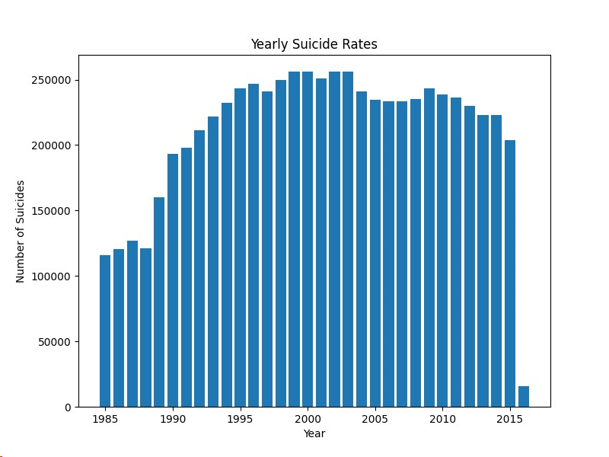
Yearly suicides rate analysis

Slide 52
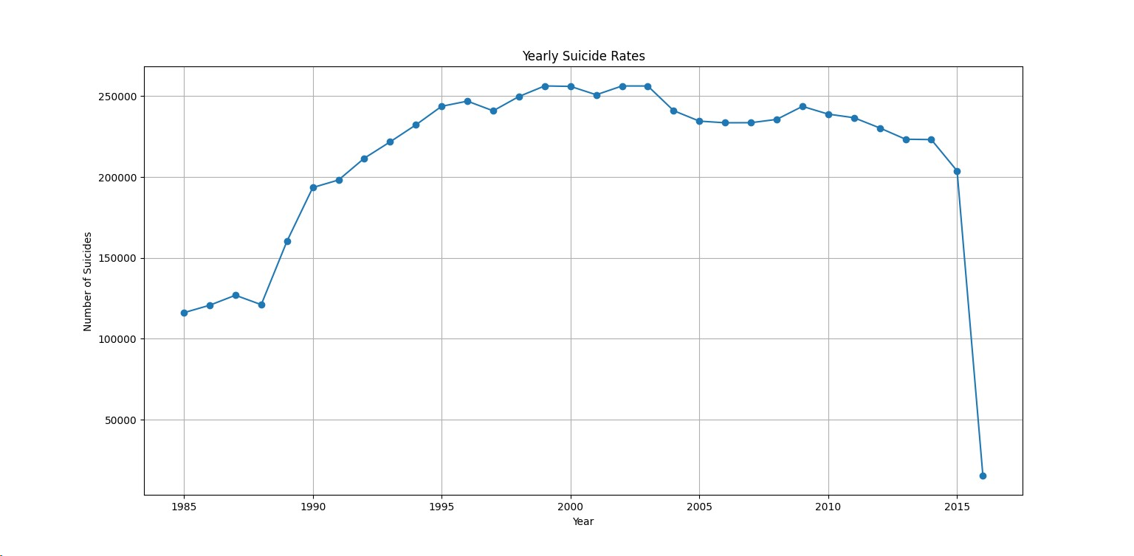

Slide 53
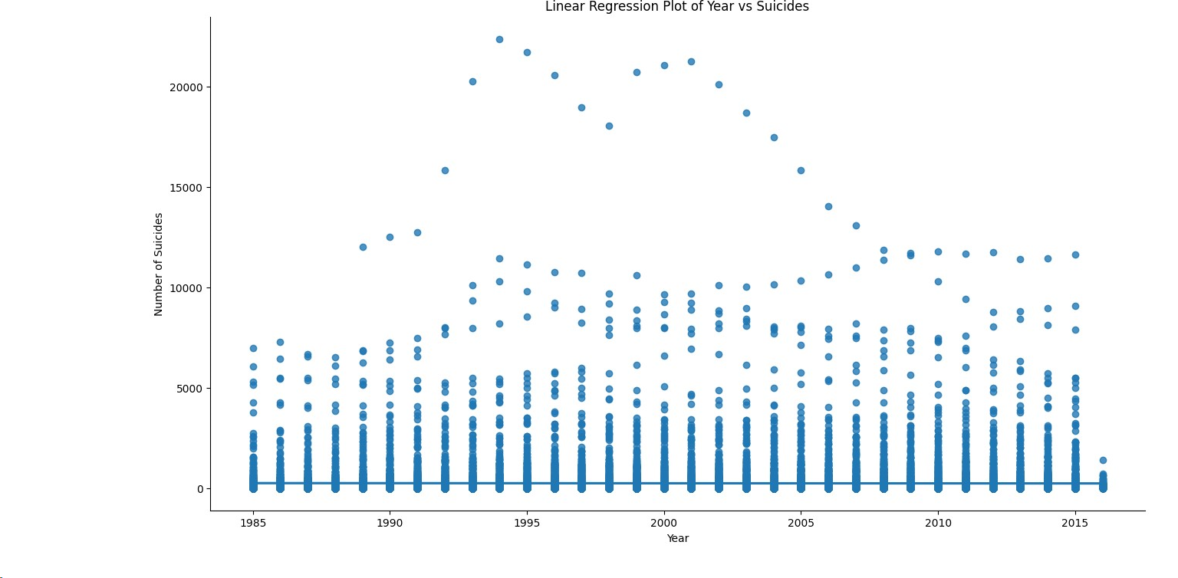

Slide 54
So, we can conclude from above graph -:
In 2016, the suicide rate was very low. However, after 1990, the suicide rate began to increase.

Slide 55
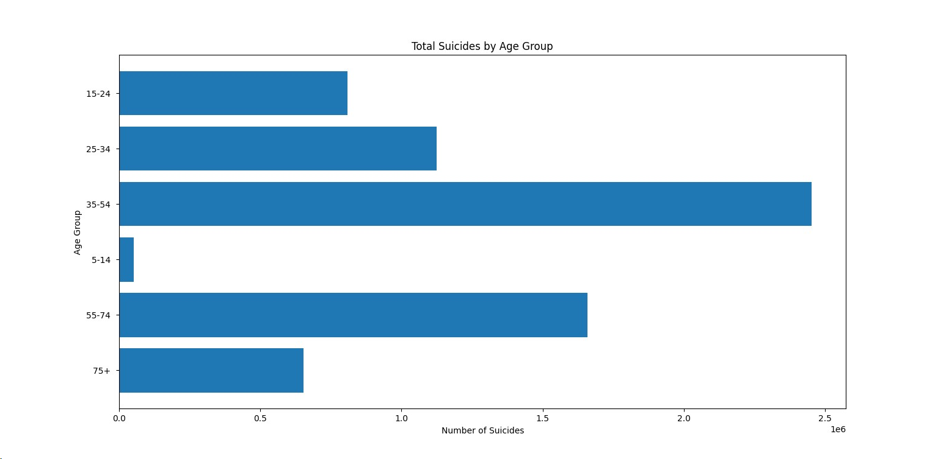
Checking suicides_no by age-group

Slide 56
So, we can conclude from above graph -:
The age group 35-54 has the highest suicide rates, while the age group 5-14 has the lowest suicide rates.

Slide 57
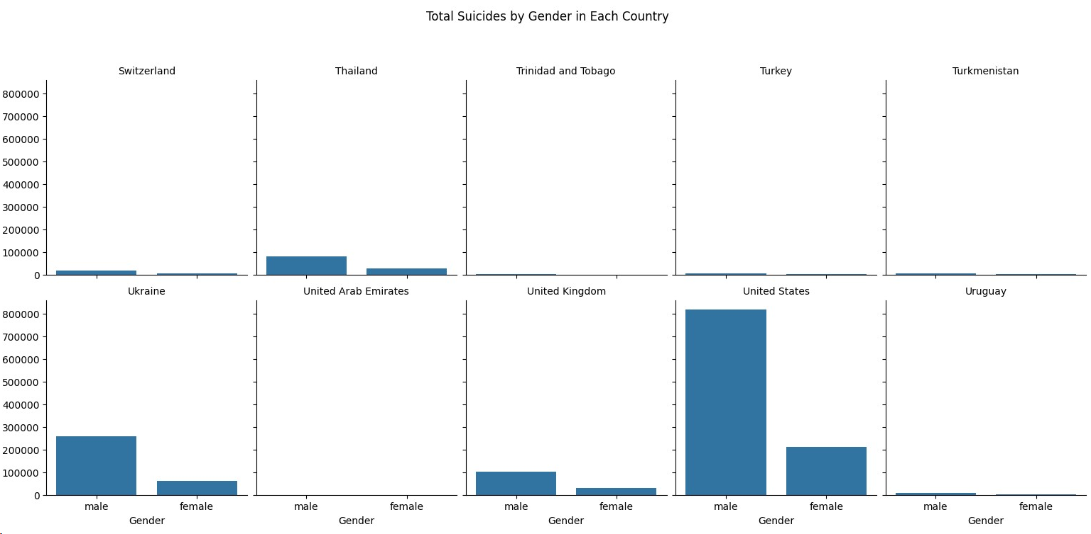
Country+gender suicide rate analysis

Slide 58
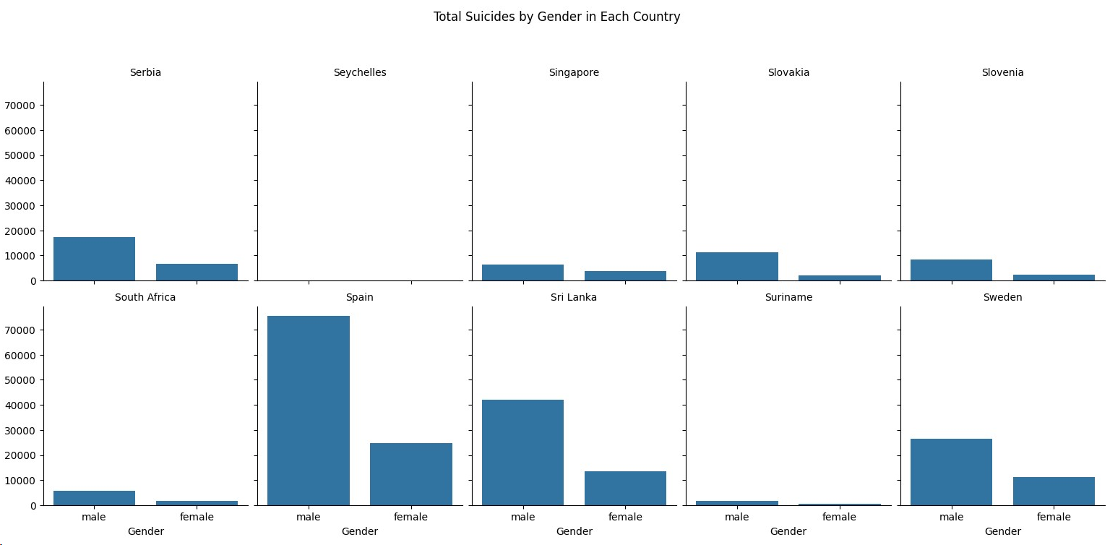

Slide 59
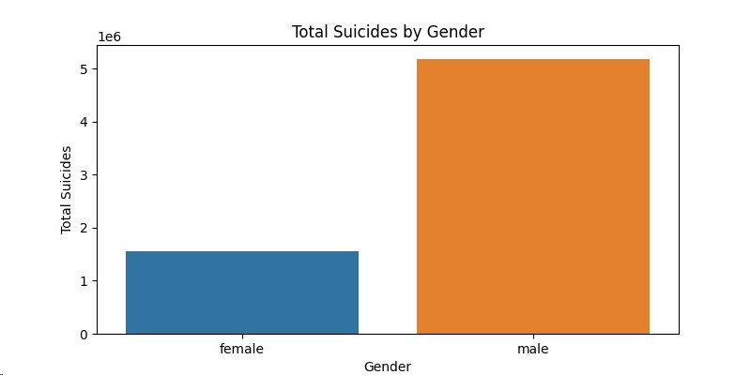
Count of suicides by gender

Slide 60
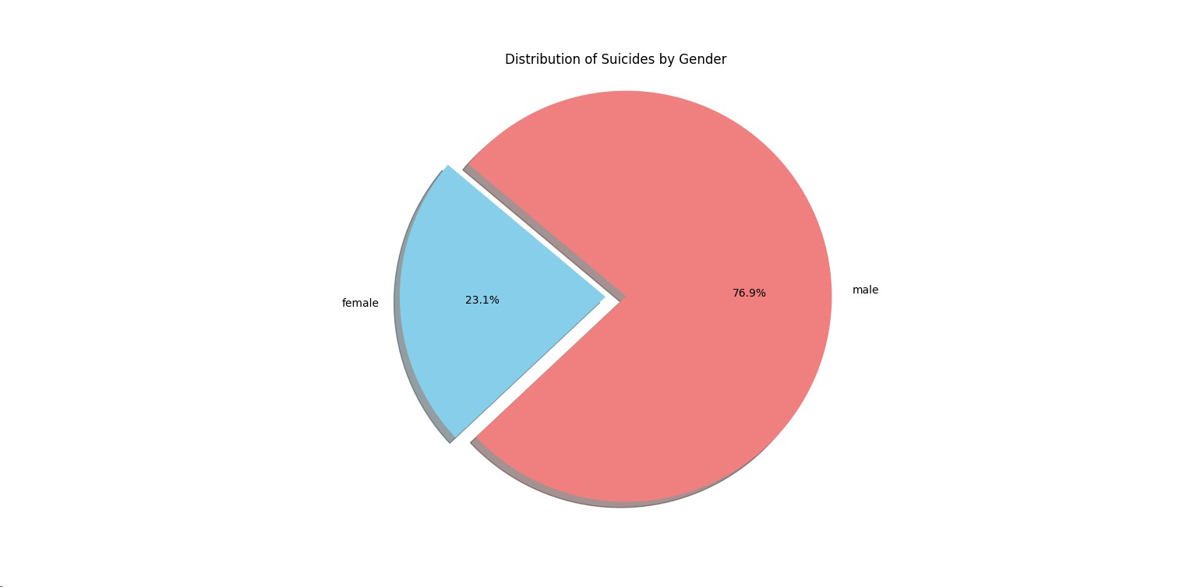

Slide 61
So, we can conclude from above graph -:
The male suicide rate is three times higher than the female suicide rate, with males accounting for 76.9% and females for 23.1% of suicides.

Slide 62
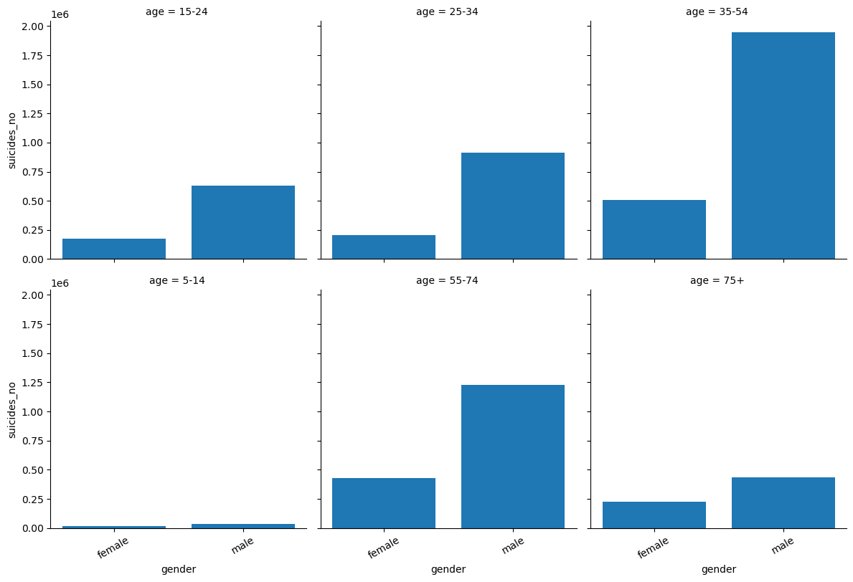
Age+Gender suicide rate analysis

Slide 63
So, we can conclude from above graph -:
Among both males and females, the age group 35-54 has the highest suicide rates, while the age group 5-14 has the lowest suicide rates for both genders.

Slide 64
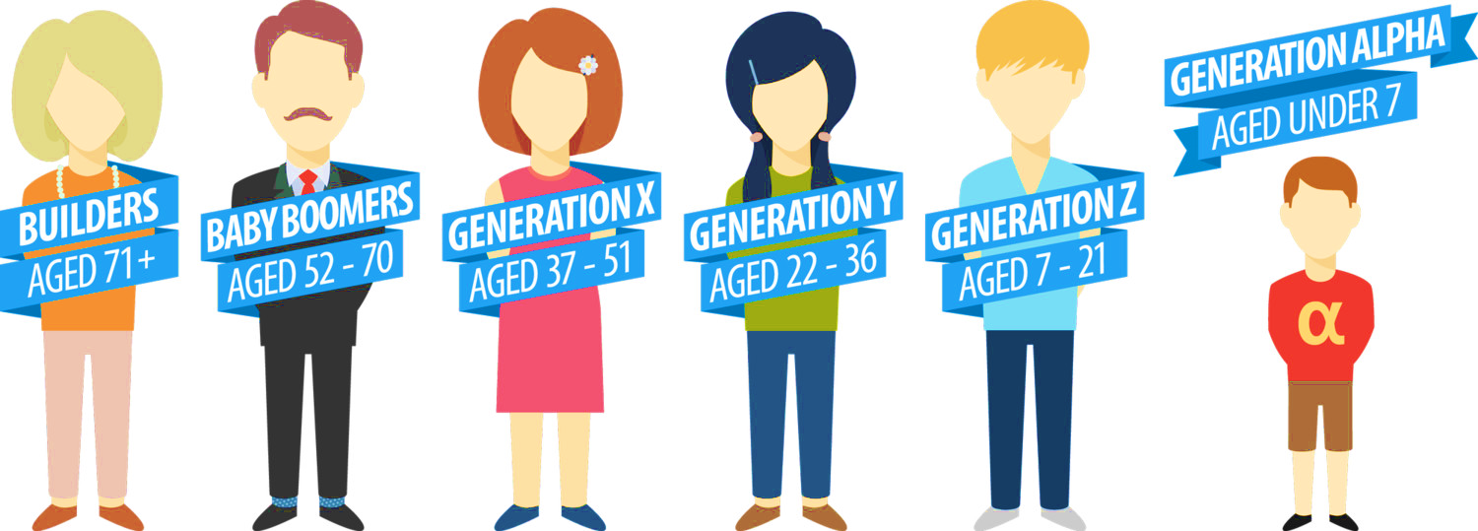
Generation Anlysis -:
Generation Z : small children(5-14)
Millenials : Youngesters + smallchildren (5-34)
Boomers : Youngsters + Middle_age (25-74)
Silent: Middle_age (35-75)
Generation X : Middle_age + youngesters + smallchildren (5-54)
G.I Generation : Old (55-75)

Slide 65
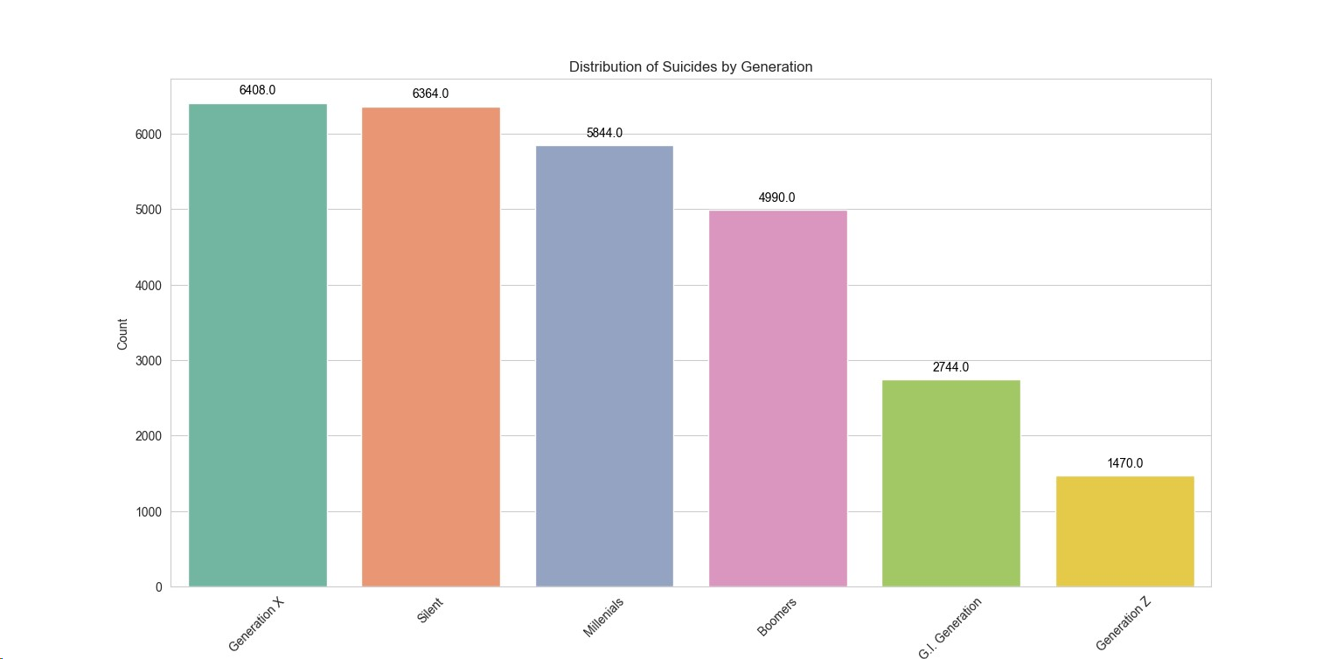
Generation Analysis

Slide 66
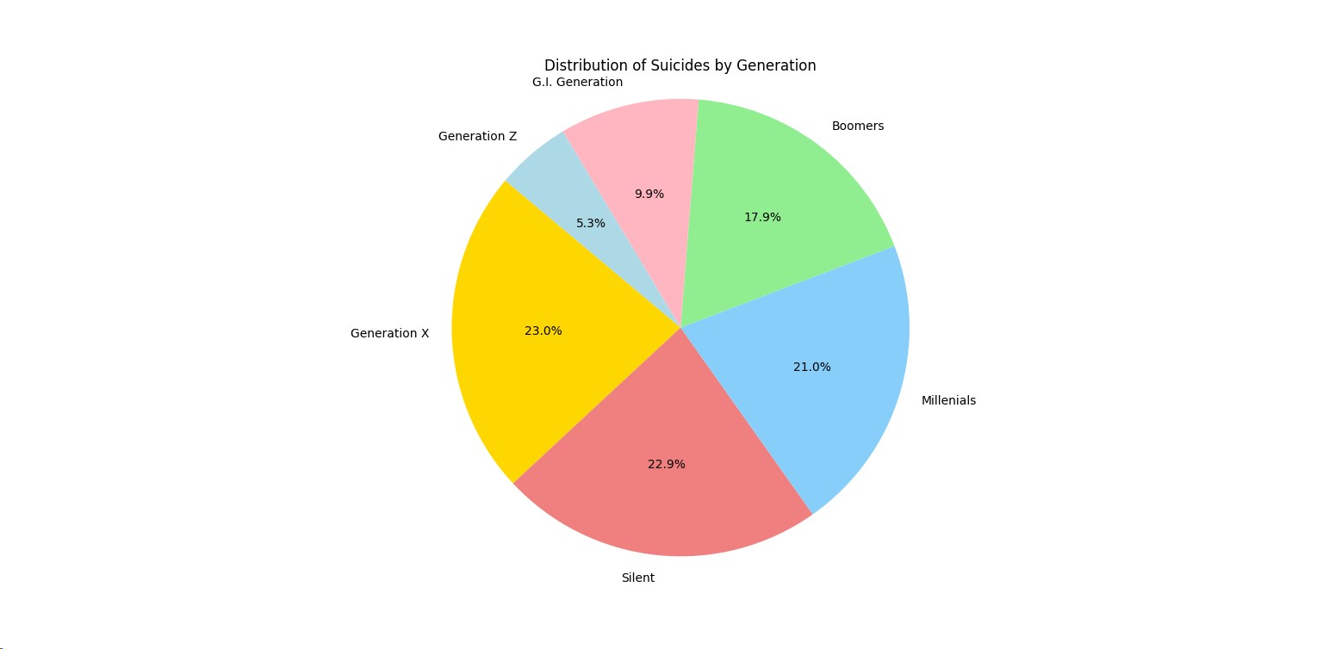

Slide 67
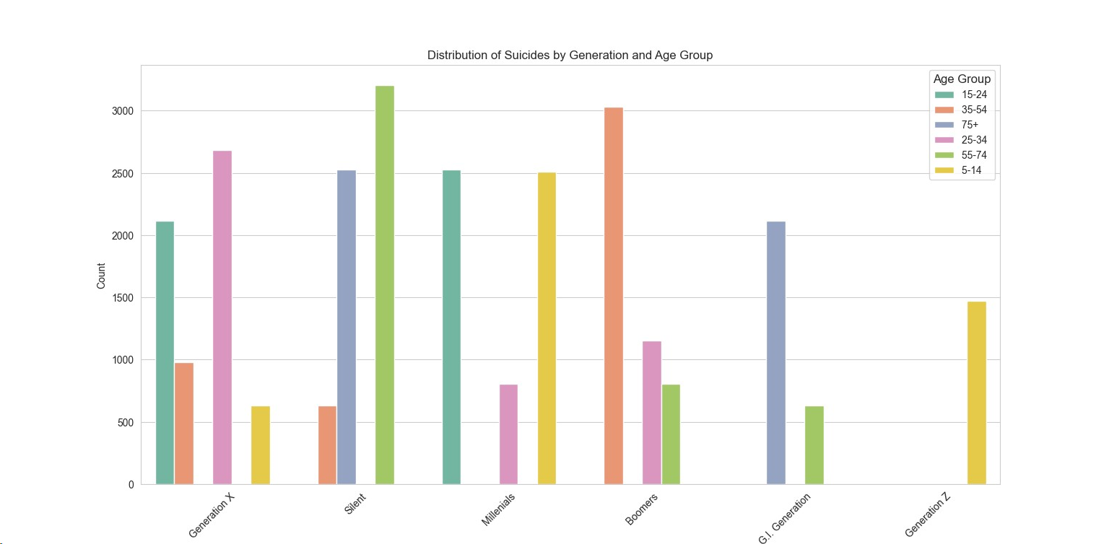
Generation + Age analysis

Slide 68
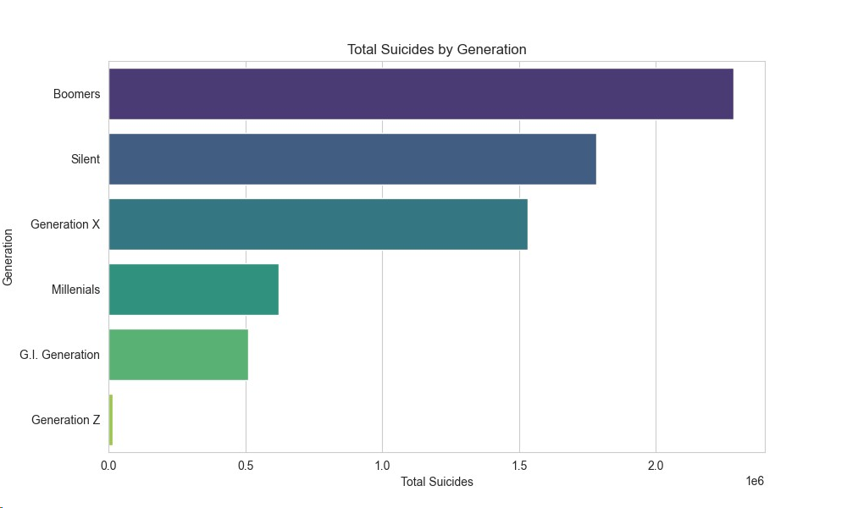

Slide 69
So, we can conclude from above graph -:
Generation Z -: small_children has very low chance to suicide
G.I Generation -: old people do but comparatively less
Millenials -: youngsters alone not much
Boomers, Silen -: middle age and youngsters are doing more suicides
generation_x -: all (small children, youngsters, middle age) so has high number.

Slide 70
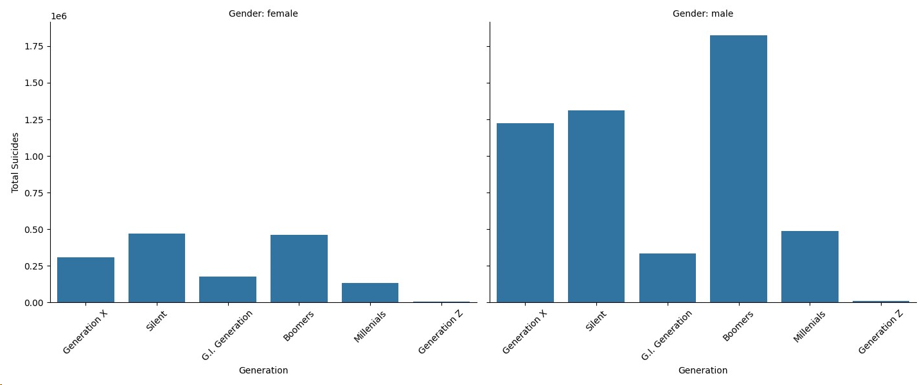

Slide 71
So, we can conclude from above graph -:
In the Boomer generation, males have a higher suicide rate, while in the Silent generation, females have a higher suicide rate. For Generation Z, both males and females have lower suicide rates.

Slide 72
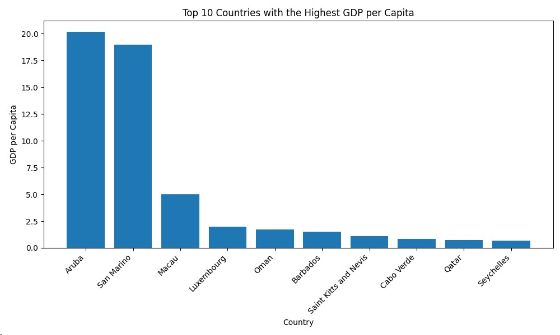
Top 10 country highest GDP

Slide 73
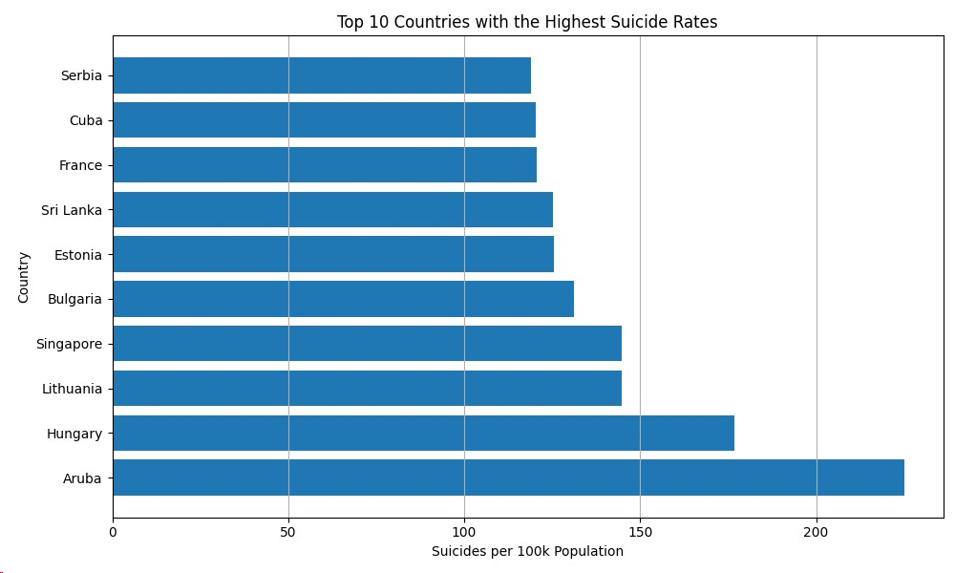
Top 10 country highest Suicide Rates

Slide 74
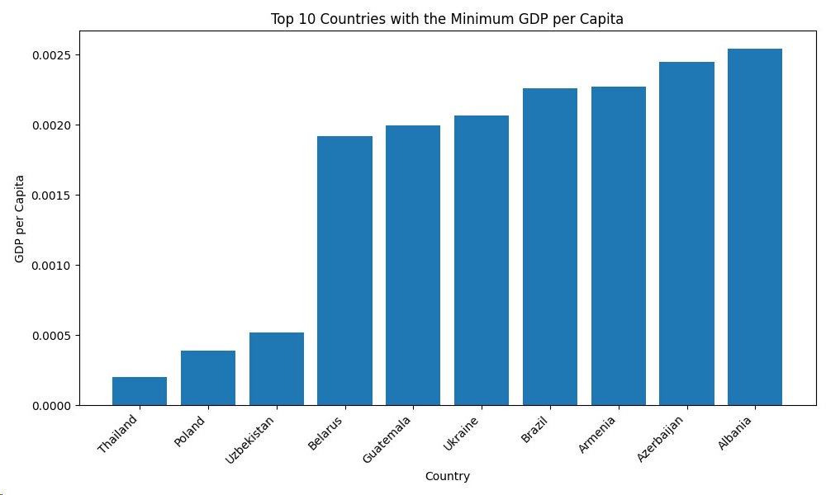
Top 10 country lowest GDP

Slide 75
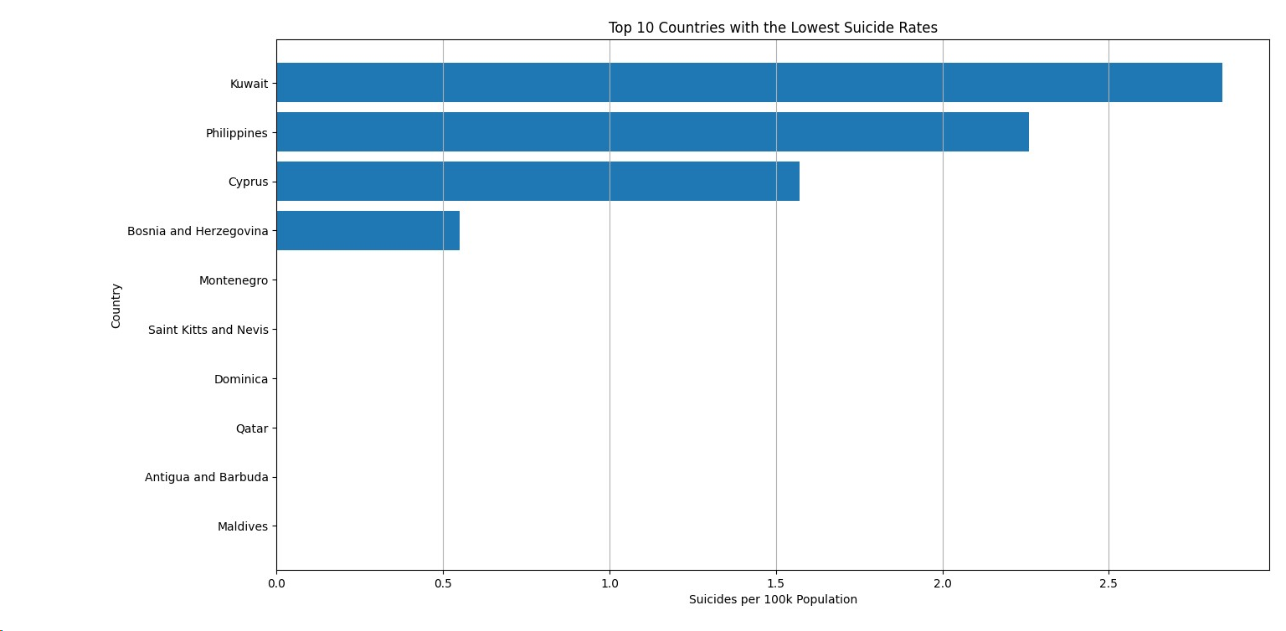
Top 10 country Lowest Suicide Rates

Slide 76
So, we can conclude from above four graph -:
Among the top 10 countries with the highest GDP per capita are Aruba, San Marino, Macau, Luxembourg, Oman, Barbados, Saint Kitts and Nevis, Cabo Verde, Qatar, and Seychelles. On the other hand, the top 10 countries with the lowest GDP per capita include Thailand, Poland, Uzbekistan, Belarus, Guatemala, Ukraine, Brazil, Armenia, Azerbaijan, and Albania.
In terms of suicide rates, the top 10 countries with the highest suicide rates are Serbia, Cuba, France, Sri Lanka, Estonia, Bulgaria, Singapore, Lithuania, Hungary, and Aruba. Meanwhile, the top 10 countries with the lowest GDP include Maldives, Antigua, Qatar, Saint Kitts and Nevis, Montenegro, Bosnia and Herzegovina, Cyprus, Philippines, and Kuwait

Slide 77
So, we can conclude the Data
It appears that there is no clear and direct correlation between a country's GDP and its suicide rates. Therefore, it's challenging to determine a straightforward relationship between a country's GDP and its suicide rates.

Slide 78
Thank You

